Slide 1



FINTECH PROJECT
PredIctIng CredIt Card Defaults WIth
MachIne LearnIng
Group Members:
İsmail Talha ILICA
Bilal Emra Durmuş

Slide 2

PredIctIng CredIt Card Defaults WIth MachIne LearnIng
A) The goal of this project is to create a machine learning model that predicts if a customer will fail to pay their credit card bill next month. We used the UCI Credit Card Default dataset, which contains 30,000 entries. After cleaning the data and creating new variables (like average payment delays and billing ratios), we tested classification models such as Logistic Regression, Random Forest, and K-Nearest Neighbors.

Slide 3
PredIctIng CredIt Card Defaults WIth MachIne LearnIng
B) We also looked at how personal details such as age, gender, education level, and marital status influence the chance of missing a payment. We judged how well the models worked using tools like F1-scores and confusion matrices. This work demonstrates how machine learning can help with making actual financial decisions.

Slide 4
Names of the Models used ın the project
Logistic Regression
Random Forest Classifier
K-Nearest Neighbors (KNN)

Slide 5
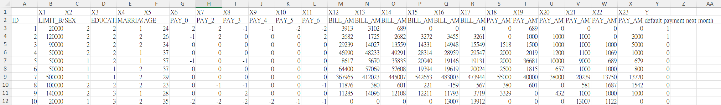
Dataset ınformatıon and sample
We used a simple yes/no variable for default payment (Yes = 1, No = 0) as the main target. We looked at previous research and chose the following 23 variables to explain the results: X1 is the credit limit (in NT dollars), covering both the individual and their family. X2 is Gender (1 for male, 2 for female). X3 is Education (1 for graduate school, 2 for university, 3 for high school, 4 for others). X4 is Marital status (1 for married, 2 for single, 3 for others). X5 is Age in years. Variables X6 through X11 track payment history from April to September 2005. Specifically: X6 is the status in September, X7 is August, down to X11 in April. The scale uses -1 for paying on time, 1 for a one-month delay, up to 9 for delays of nine months or more. Variables X12 to X17 show the bill statement amounts (in NT dollars) for those same months. Finally, X18 to X23 represent the actual amount paid (in NT dollars) for each month from September back to April.

Slide 6
Test set and traınıng set dıvısıon
The dataset was split into training and test sets using a 70–30 ratio. As a result, approximately 20,300 records were used for training and 8,700 for testing.
%30 Test Set
%70 Train Set

Slide 7
Confusıon matrıCes
1 | KNN
 | Positive | Negative
Positive | 1220 | 2163
Negative | 762 | 4736
2 | Logistic Regression
 | Positive | Negative
Positive | 1201 | 1566
Negative | 781 | 5333
3 | Random Forest
 | Positive | Negative
Positive | 947 | 827
Negative | 1035 | 6072

Slide 8
Calculatıon results and comparıson
KNN: Had low accuracy (67%) and precision (36%). Only the recall score (62%) was decent.
Random Forest: Achieved the best accuracy (79%). However, it was not good at finding defaults (recall was only 48%), meaning it misses risky customers.
Logistic Regression: Was the most balanced model (F1 score: 51%). It was the best at spotting defaults (recall: 61%).
Performance Metric | Logistic Regression | Random Forest | KNN
Accuracy | 74% | 79% | 67%
Presicion | 43% | 53% | 36%
Recall | 61% | 48% | 62%
F1-Score | 51% | 50% | 45%

Slide 9
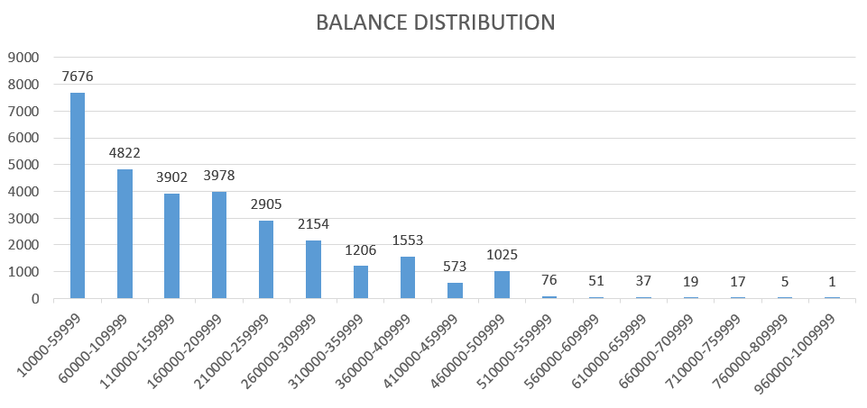
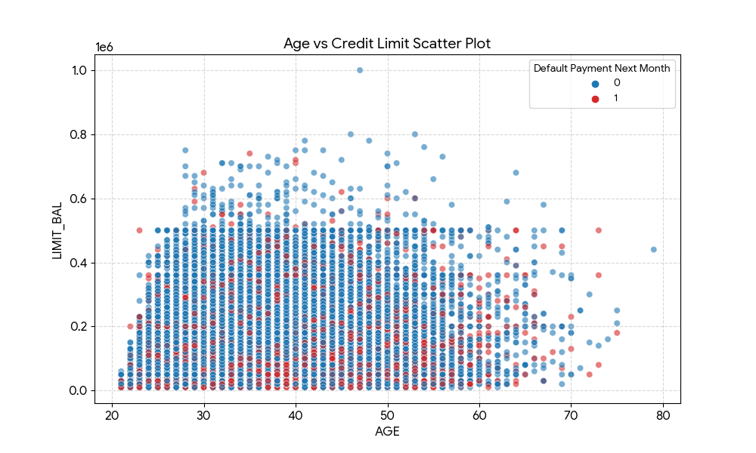
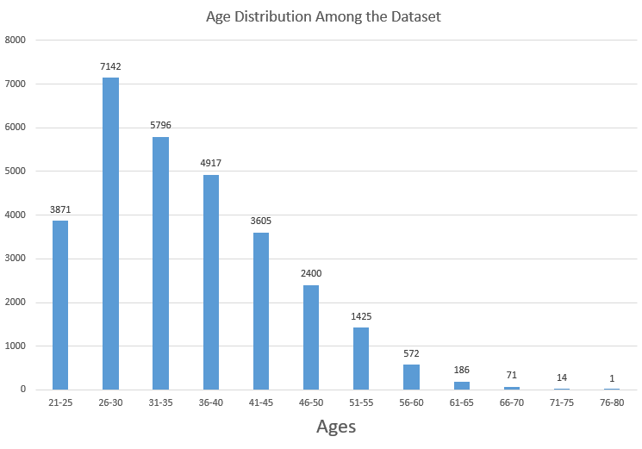

Slide 10
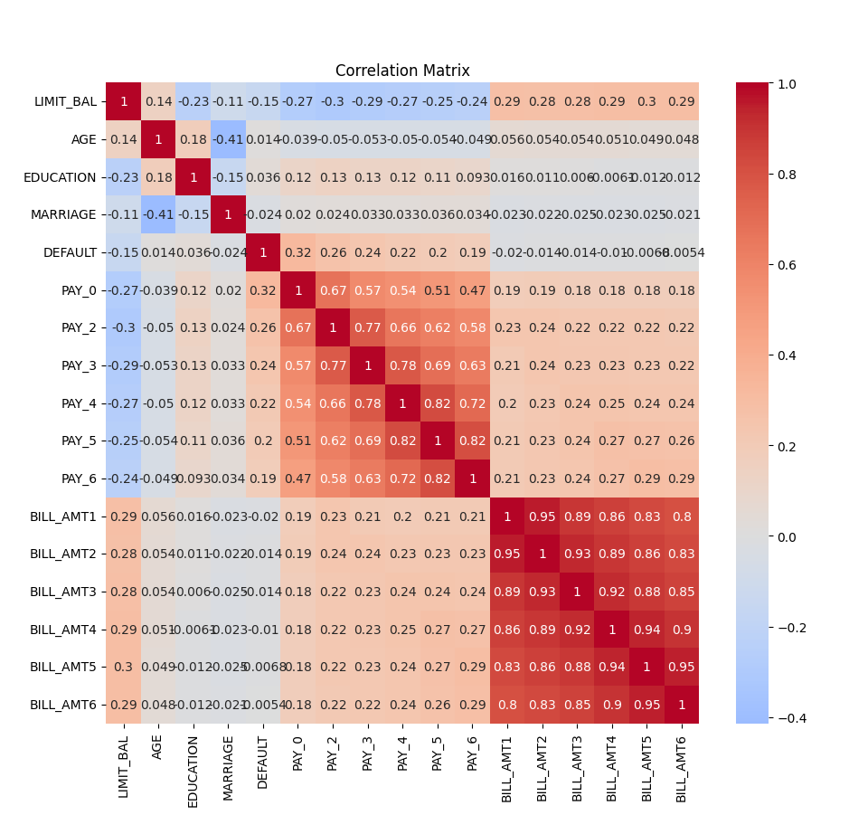

Slide 11
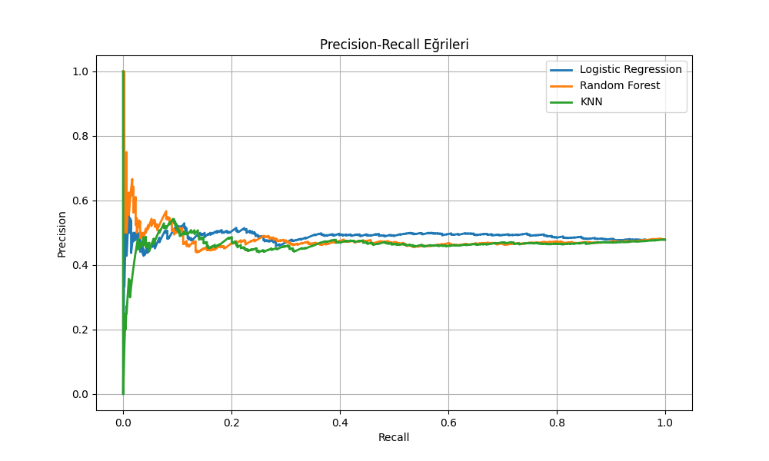
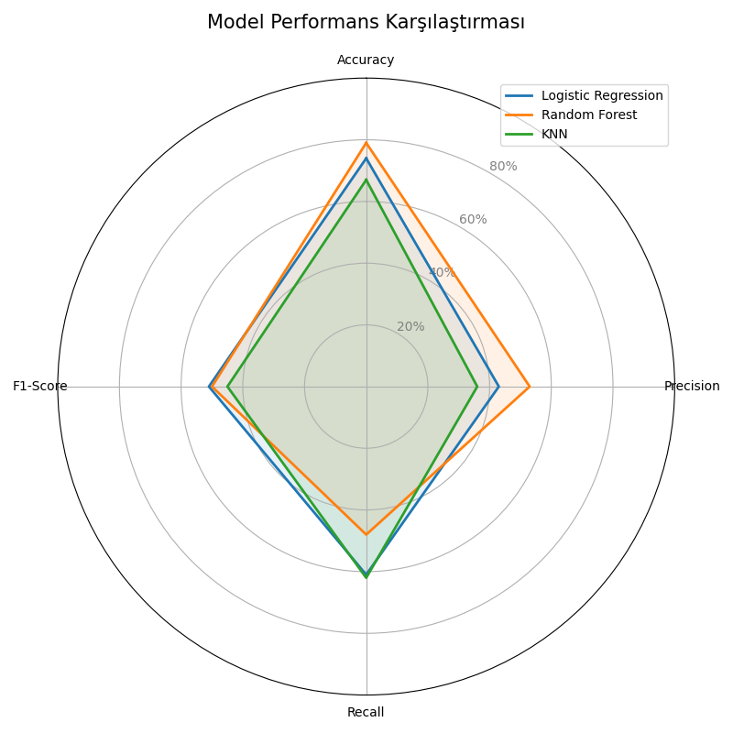
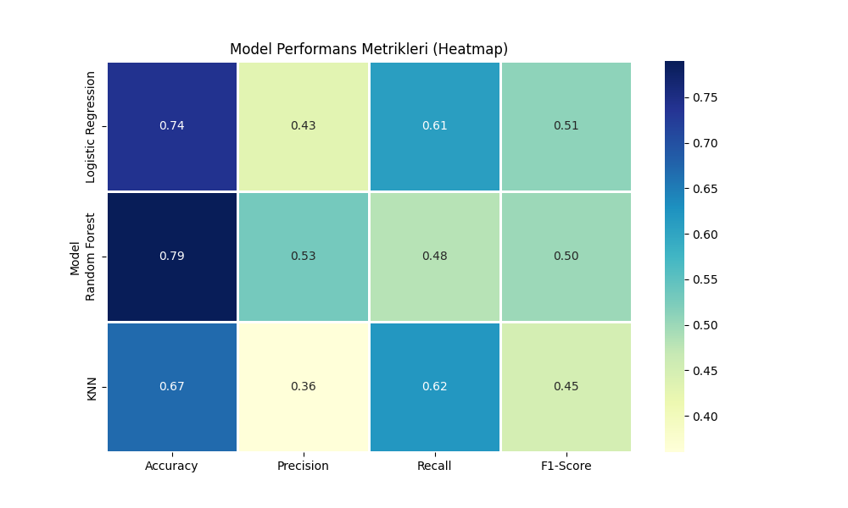

Slide 12
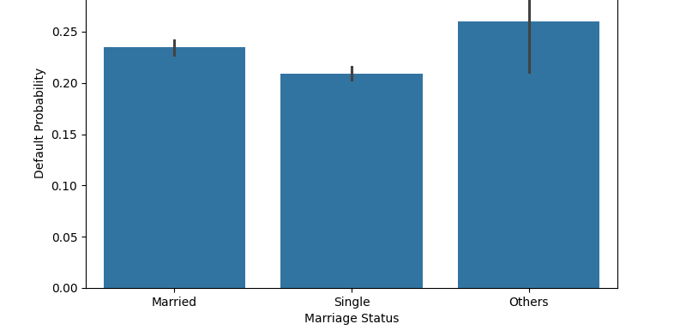
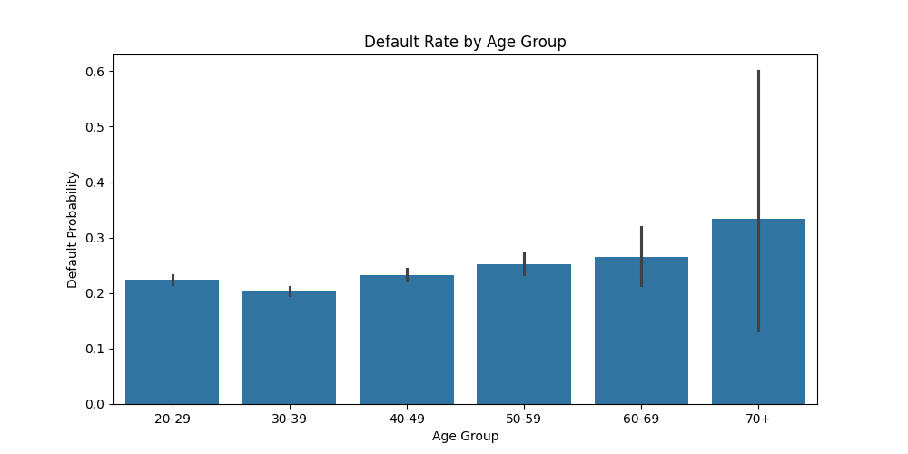
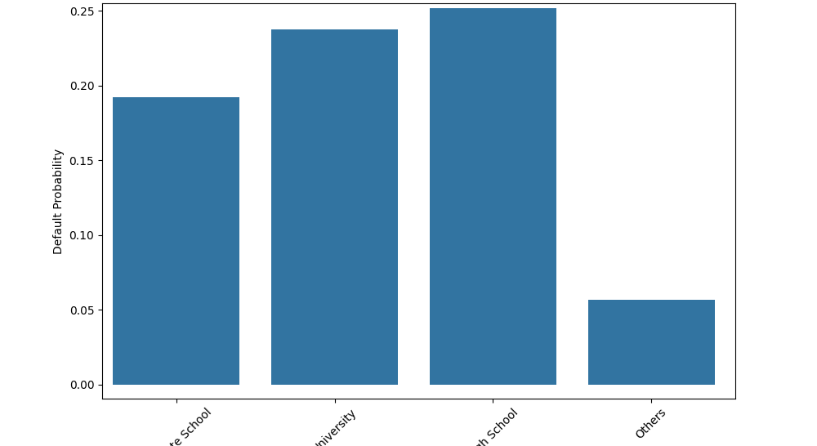
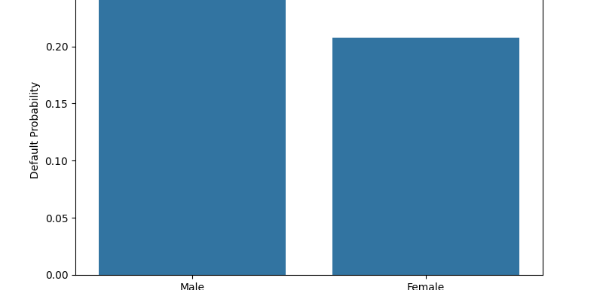

Slide 13
Conclusıon
In this project, we built and compared three machine learning models to predict who might miss credit card payments. Although the Random Forest model had the best total accuracy, it did a poor job of identifying people who actually default. The KNN model found enough defaults but was not precise or consistent. Logistic Regression, however, offered the most balanced results with the best ability to spot defaults and a strong F1-score. Since catching potential missed payments is vital for managing financial risk, we recommend Logistic Regression as the best model to use in real situations

Slide 14
References:
https://archive.ics.uci.edu/dataset/350/default+of+credit+card+clients
https://www.datylon.com/blog/types-of-charts-graphs-examples-data-visualization
https://scikit-learn.org/stable/user_guide.html
https://pandas.pydata.org/docs/user_guide/index.html
https://seaborn.pydata.org/tutorial.html

